Slide 1
Hello World

Slide 2
code used in training
you can find all of the code shown in this training here:
https://github.com/GoesToEleven/GolangTraining

Slide 3
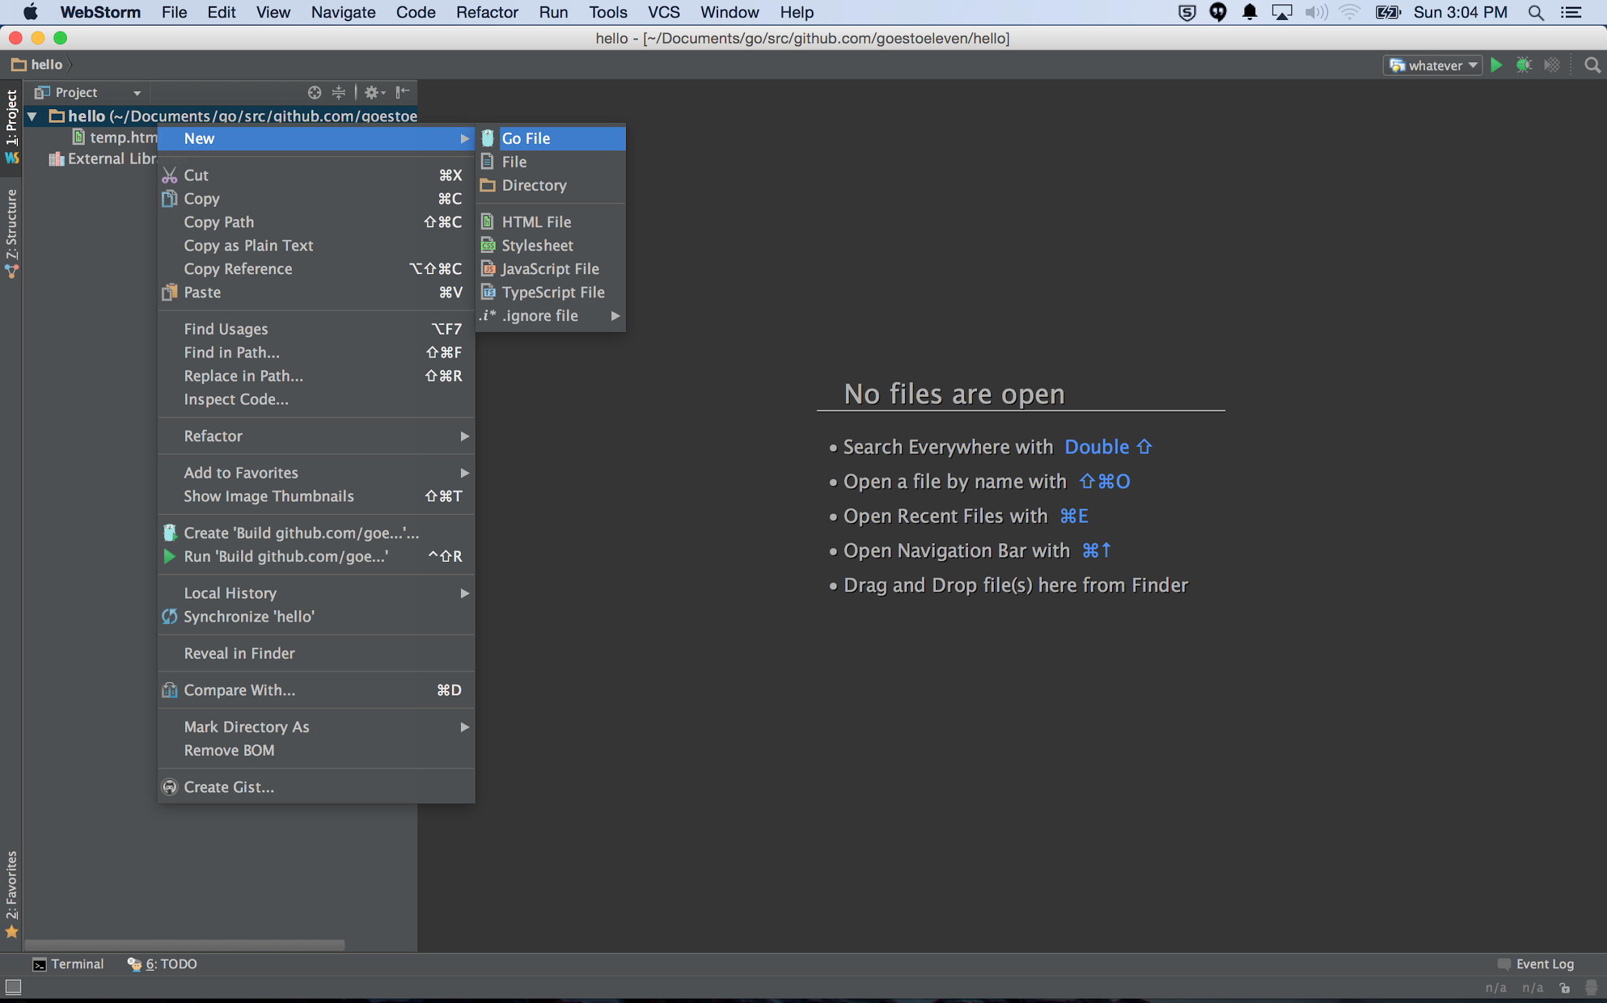

Slide 4
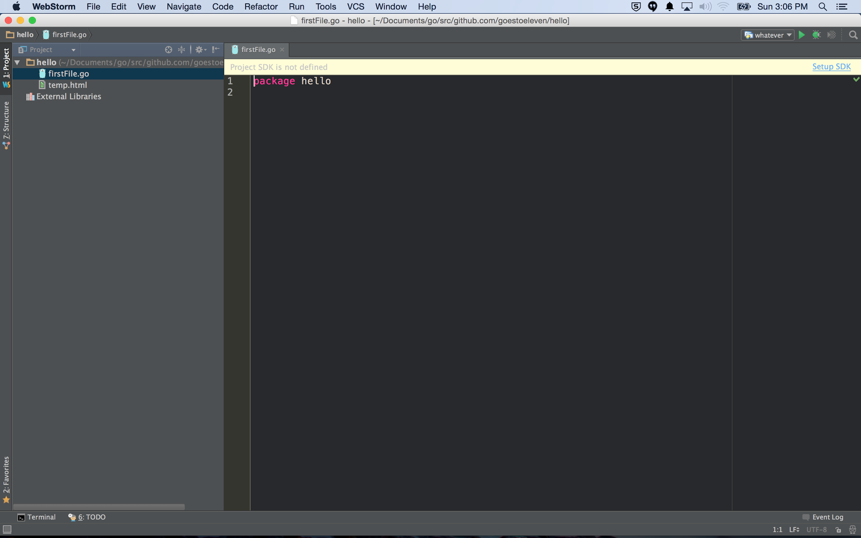

Slide 5
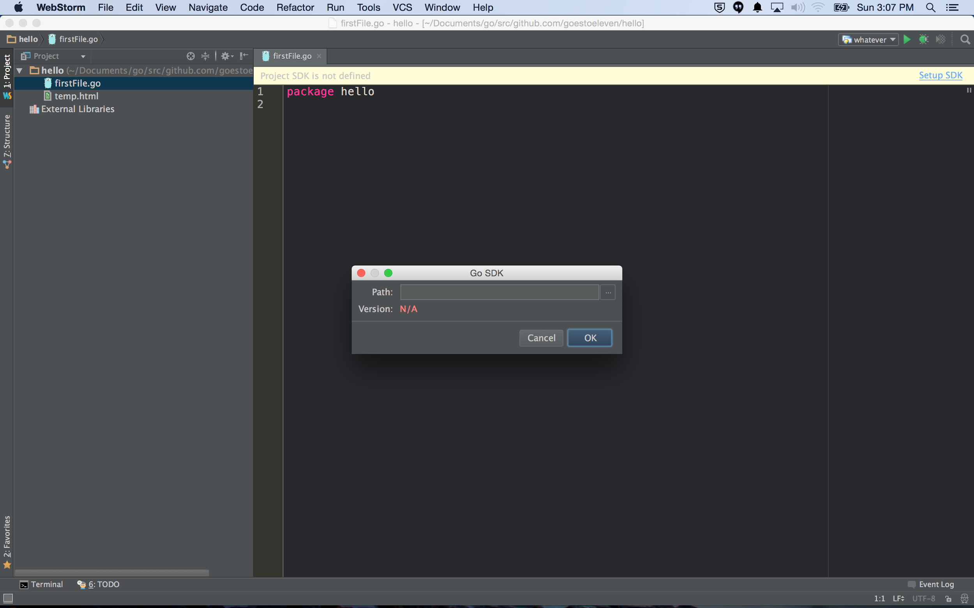

Slide 6
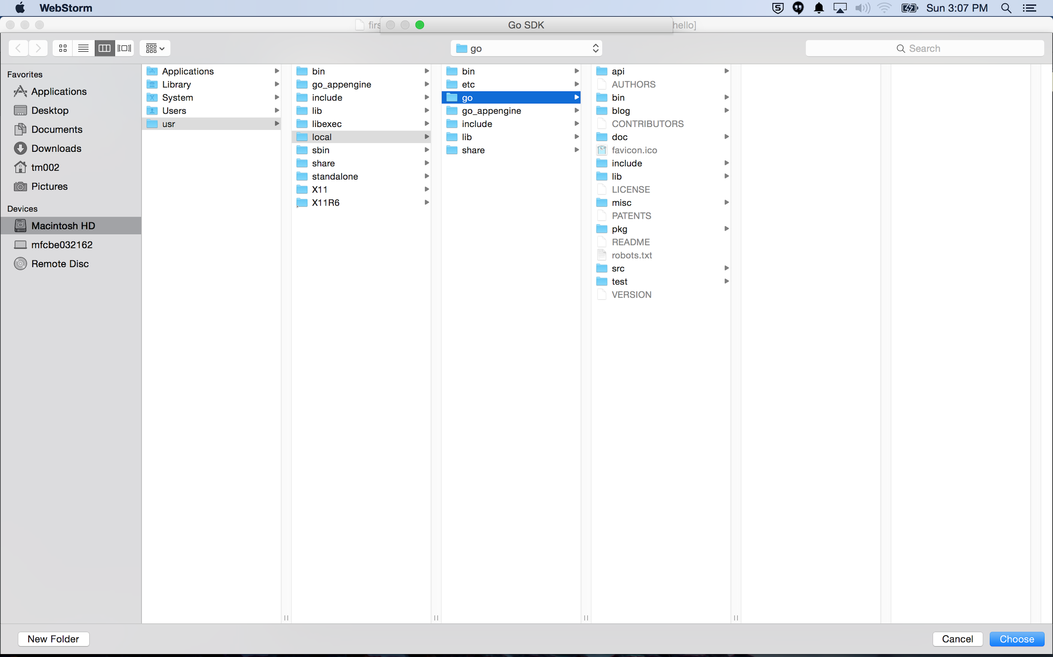

Slide 7
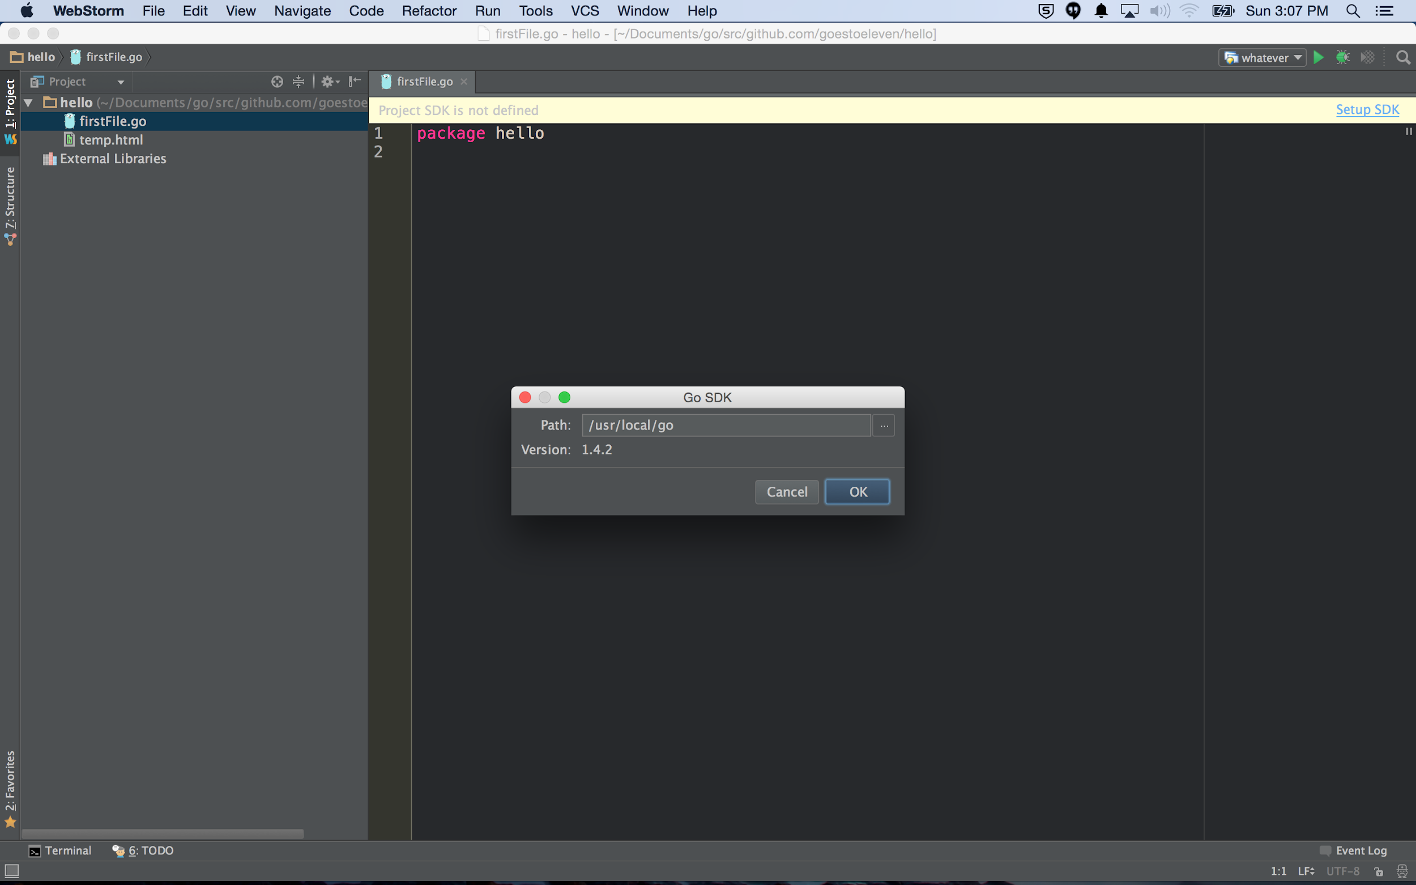

Slide 8
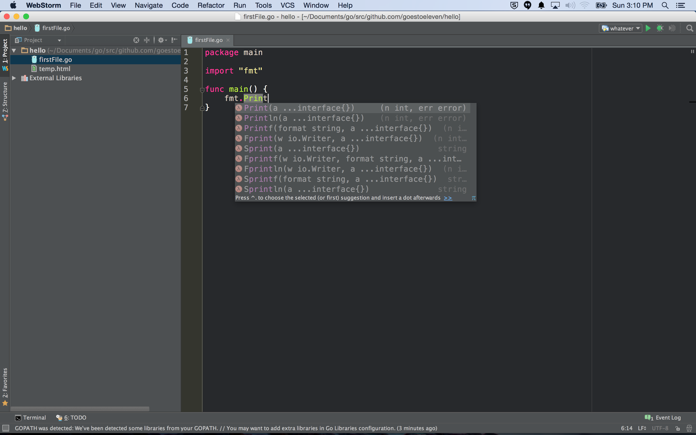
Code completion

Slide 9
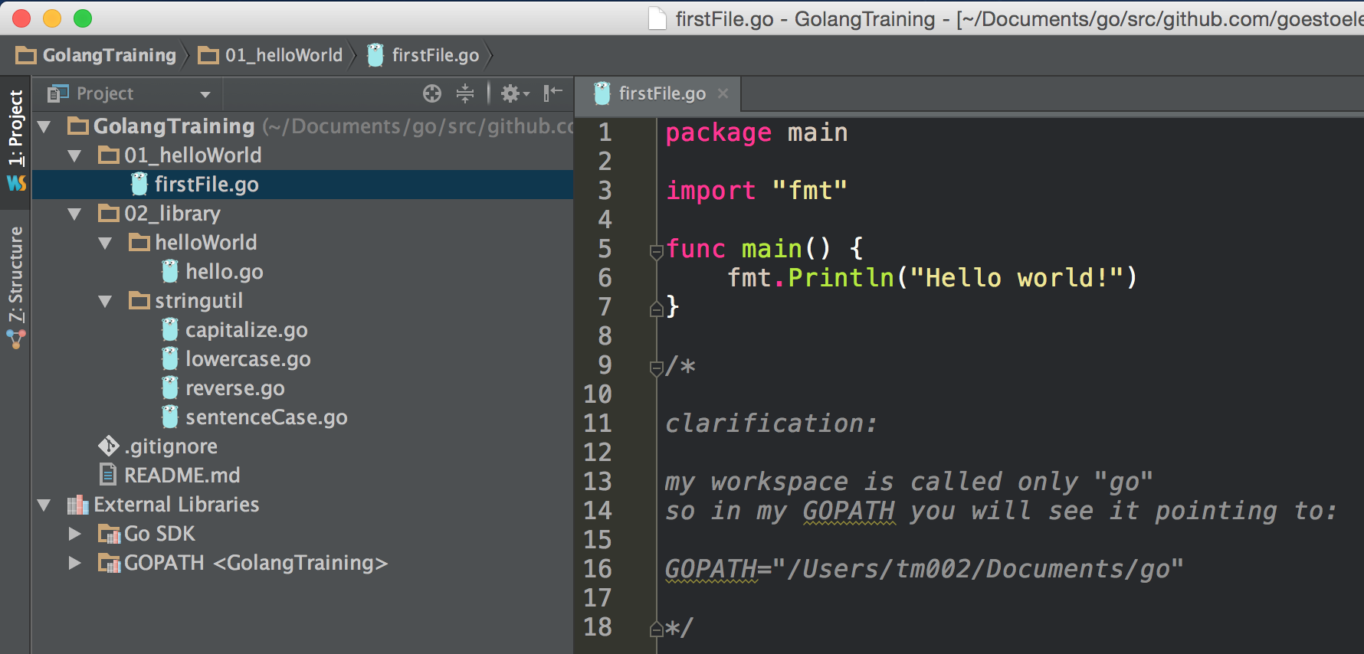
Every go file begins with a package name. The name of the package must be the same as the folder name except for package main. Package main is the entry point for your program.
If you are using code from other packages, you list the packages that you want to import. This allows you to use code in your program that other people have written. Packages are also sometimes referred to as libraries.
The “fmt” package is being imported.
A parameter is the variable which is part of the func’s signature (func declaration). An argument is an expression used when calling the func. source: modified from stackoverflow

Slide 10
This function is declared with no (choose one):
parameters
arguments
“Hello world” is an example of a literal (choose one):
parameter
argument

Slide 11
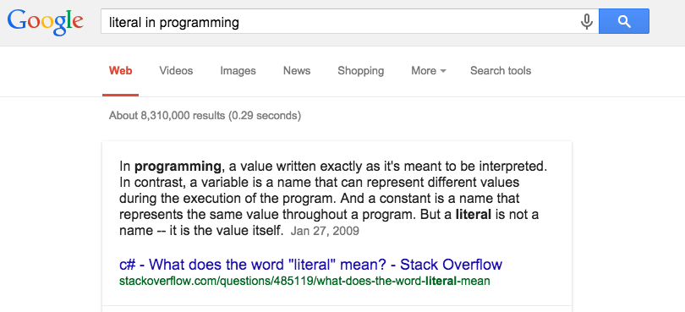

Slide 12
Every go file begins with a package name. The name of the package must be the same as the folder name except for the main package. The main package is the entry point for your program.
If you are using code from other packages, you list the packages that you want to import. This allows you to use code in your program that other people have written. Packages are also sometimes referred to as libraries.
The “fmt” package is being imported.
Code from the “fmt” package is being used. Println is a function declared in the “fmt” package. For a function to be accessible to other packages, it must be Capitalized. This is analogous to “public” in other languages.
A parameter is the variable which is part of the func’s signature (func declaration). An argument is an expression used when calling the func. source: modified from stackoverflow
The func main() is the entry point for your program; the first code that will run. The package main can also have other functions besides func main().
An expression specifies the computation of a value by applying operators and functions to operands. source: effective go
Statements control execution. source: effective go

Slide 13
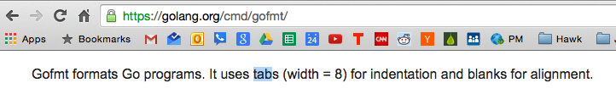
Every go file begins with a package name. The name of the package must be the same as the folder name except for the main package. The main package is the entry point for your program.
If you are using code from other packages, you list the packages that you want to import. This allows you to use code in your program that other people have written. Packages are also sometimes referred to as libraries.
The “fmt” package is being imported.
Code from the “fmt” package is being used. Println is a function declared in the “fmt” package. For a function to be accessible to other packages, it must be Capitalized. This is analogous to “public” in other languages.
A parameter is the variable which is part of the func’s signature (func declaration). An argument is an expression used when calling the func. source: modified from stackoverflow
The func main() is the entry point for your program; the first code that will run. The package main can also have other functions besides func main().
An expression specifies the computation of a value by applying operators and functions to operands. source: effective go
Statements control execution. source: effective go

Slide 14
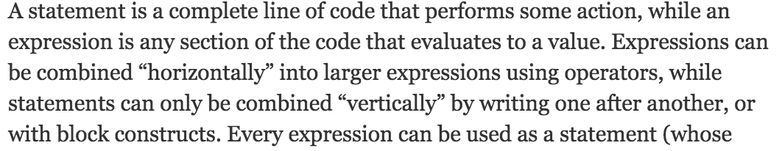
http://www.quora.com/Whats-the-difference-between-a-statement-and-an-expression-in-Python

Slide 15
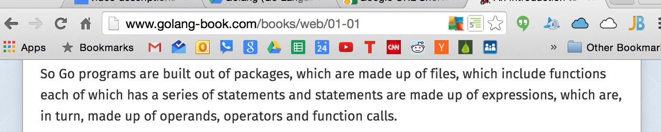

Slide 16
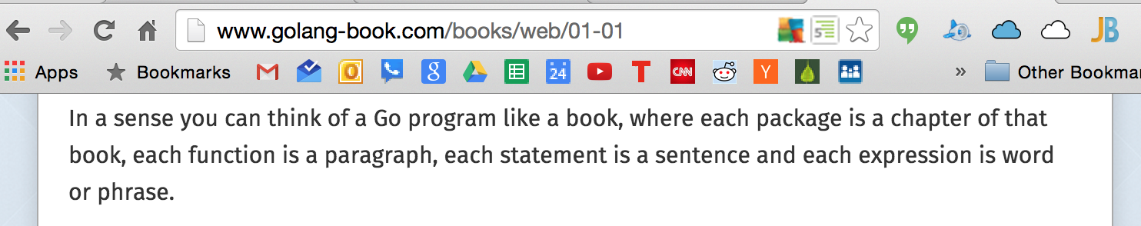

Slide 17
“Hello world” is a (choose one):
statement
expression

Slide 18
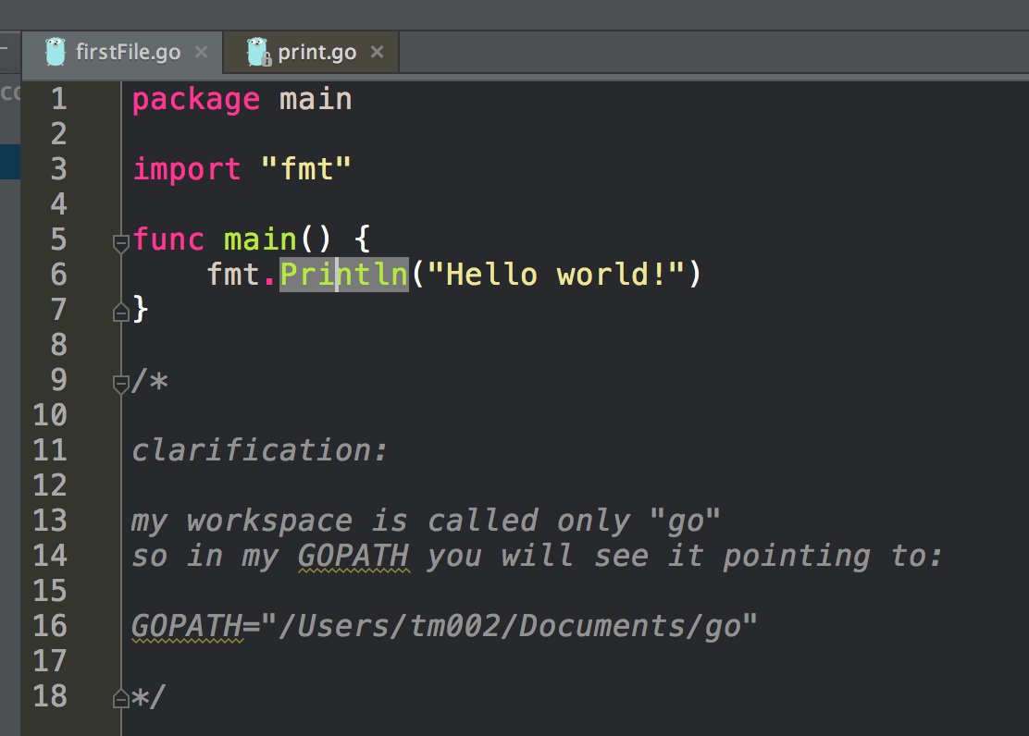
If I hold down “cmd” and click Println ...

Slide 19
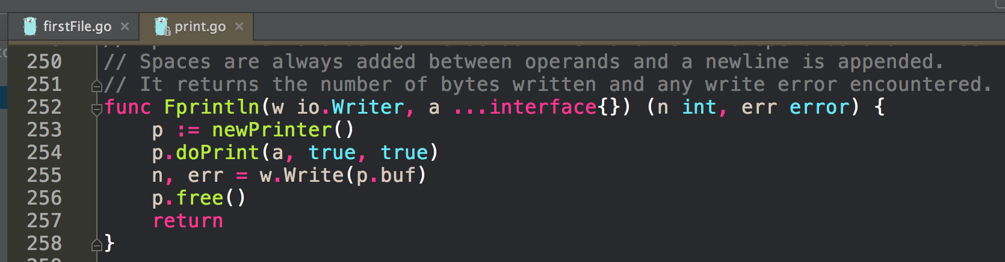
I am taken to the source code!

Slide 20
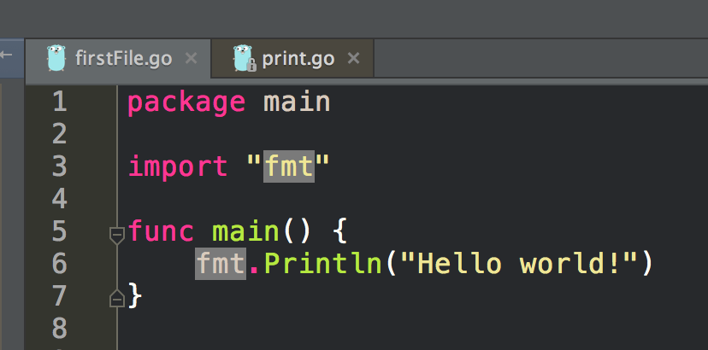
If I hold down “cmd” and click fmt ...

Slide 21
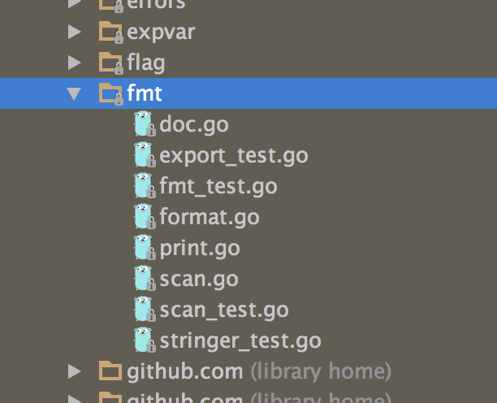
I am taken to the source code!

Slide 22
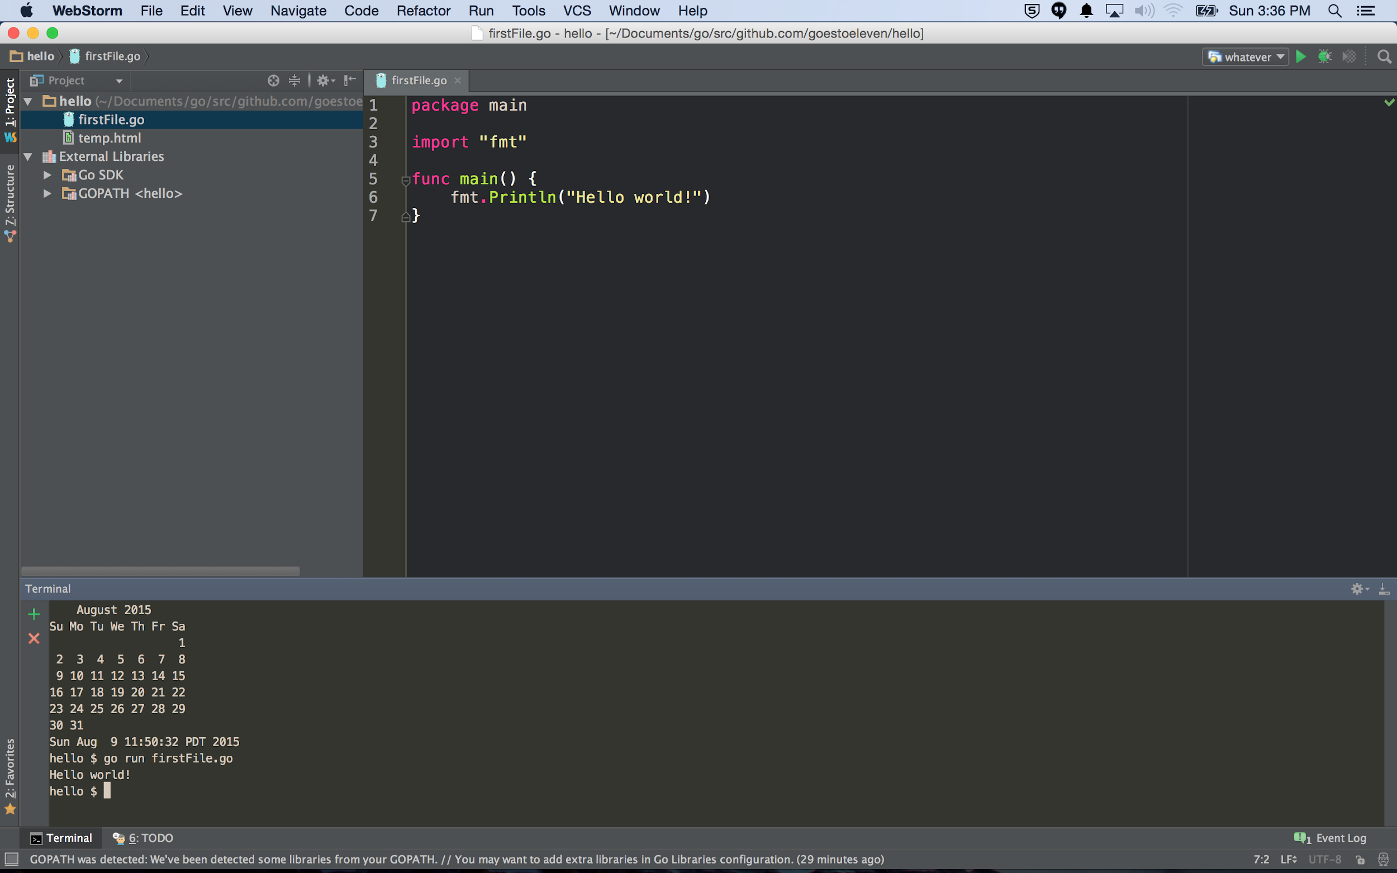
go run gofiles…
source: command go

Slide 23
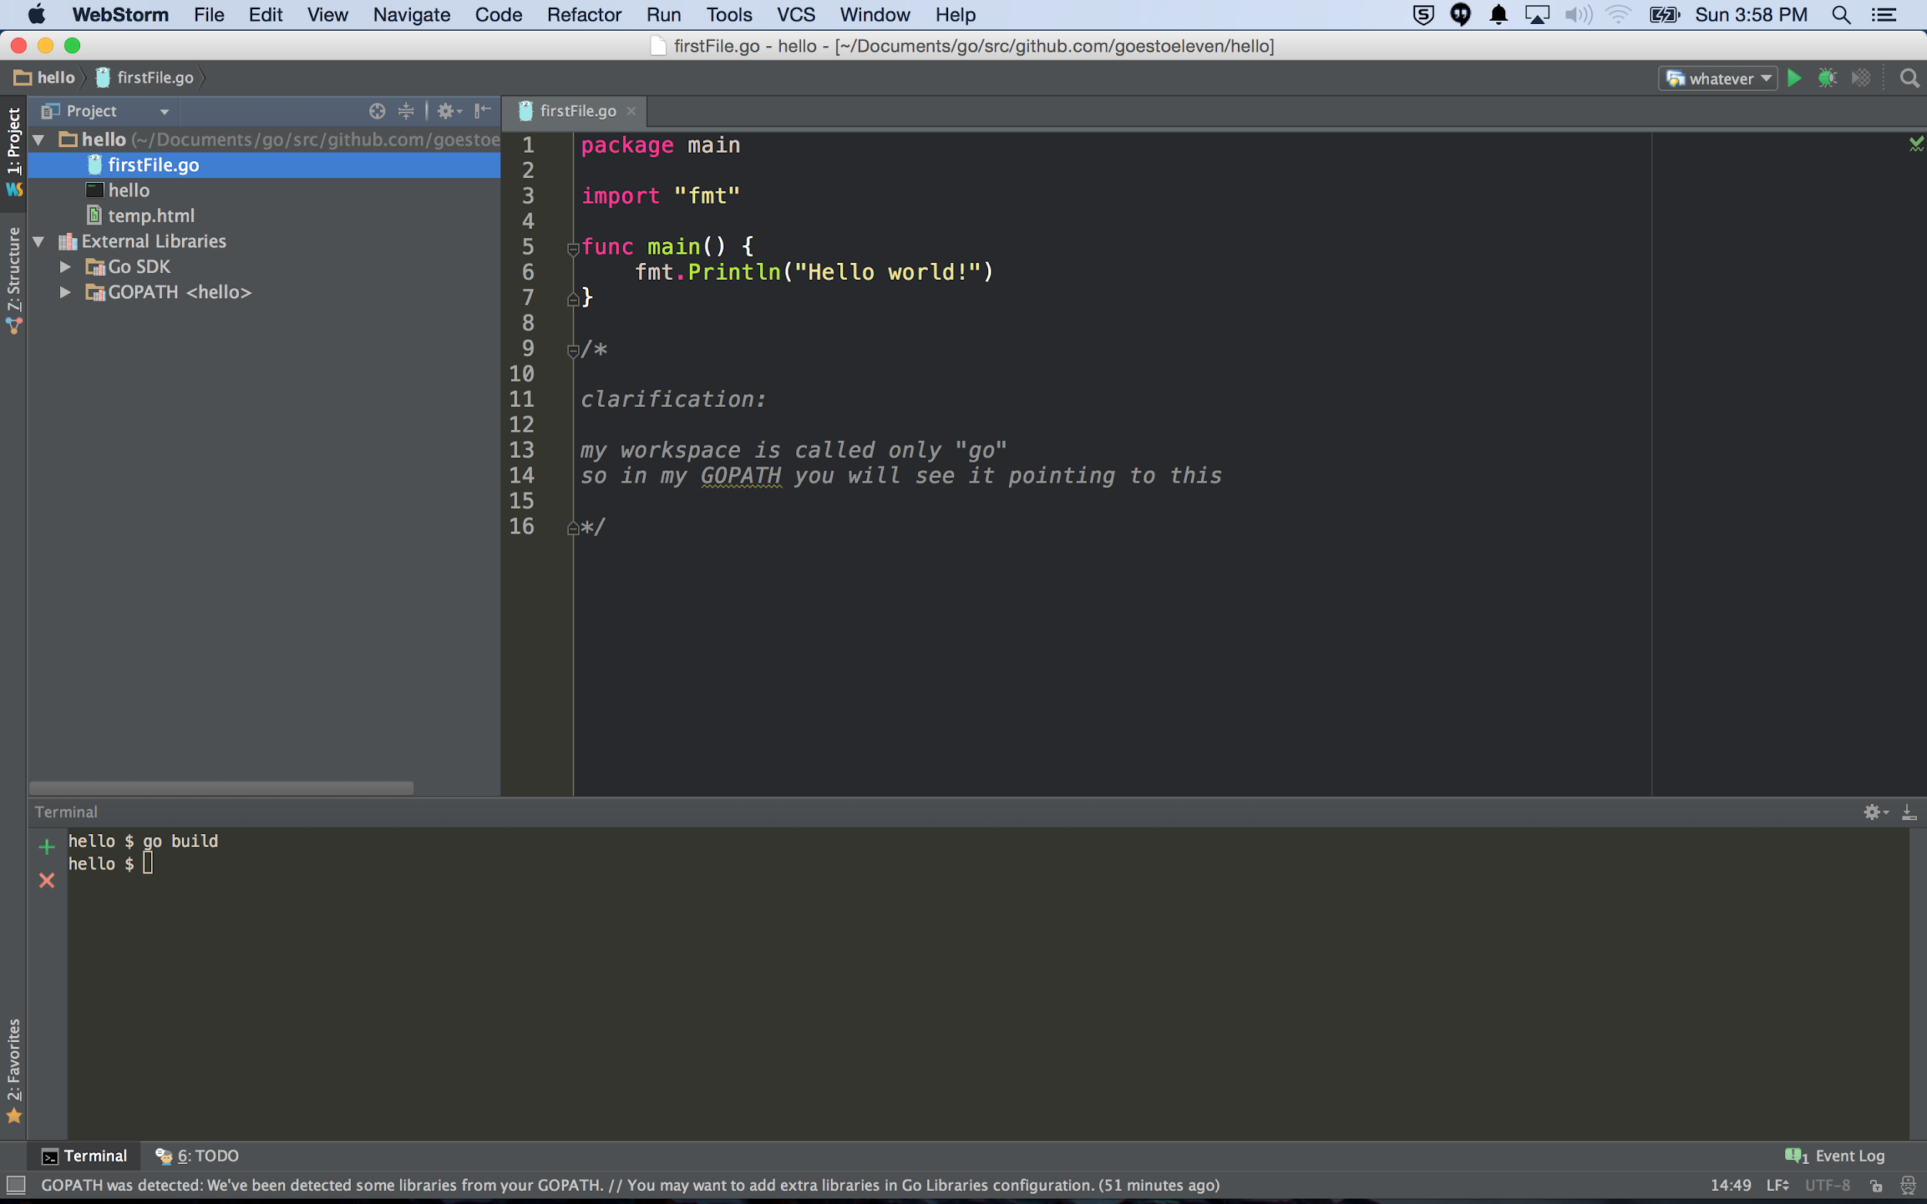
go build
As this is run in the folder with package main, it builds the file into an executable binary; if this was run in a folder that was just a library package, it would build it and show you if there were errors but not create a binary executable (it throws away the results).

Slide 24
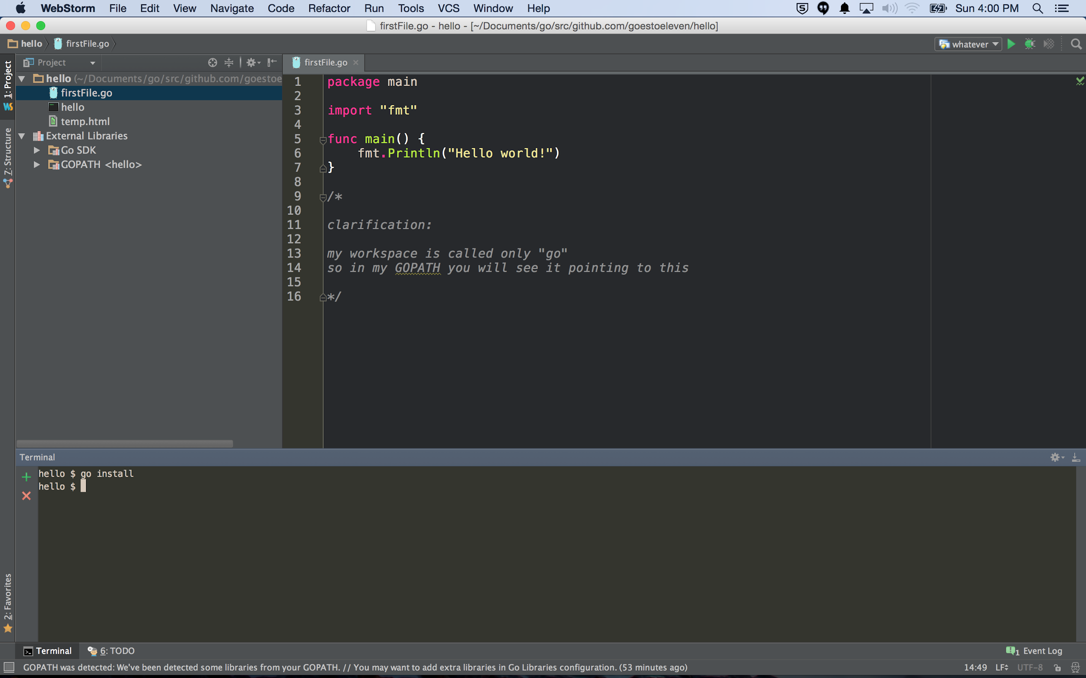
go install
As this is run in the folder with package main, it builds the file into an executable binary and puts it in “bin” under your workspace; if this was run in a folder that was just a library package, it would build it and put the results in “pkg” under your workspace.

Slide 25
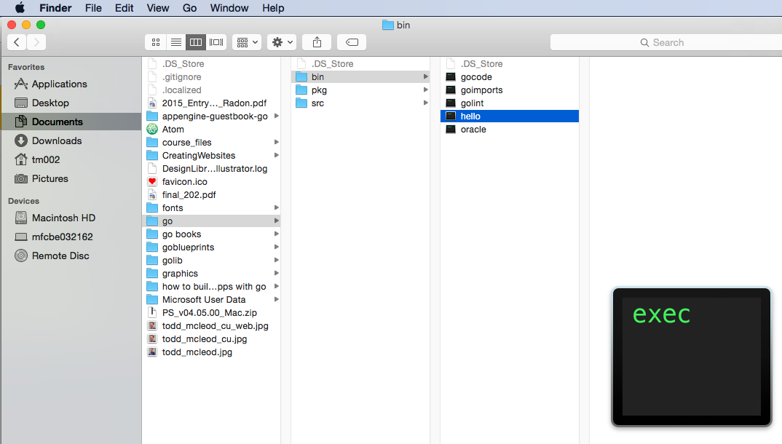
go install
As this is run in the folder with package main, it builds the file into an executable binary and puts it in “bin” under your workspace; if this was run in a folder that was just a library package, it would build it and put the results in “pkg” under your workspace.

Slide 26
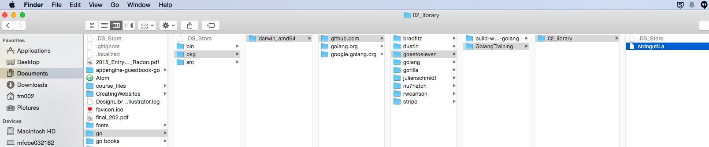
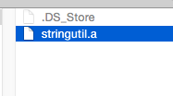
go install
As this is run in the folder with package main, it builds the file into an executable binary and puts it in “bin” under your workspace; if this was run in a folder that was just a library package, it would build it and put the results in “pkg” under your workspace.

Slide 27
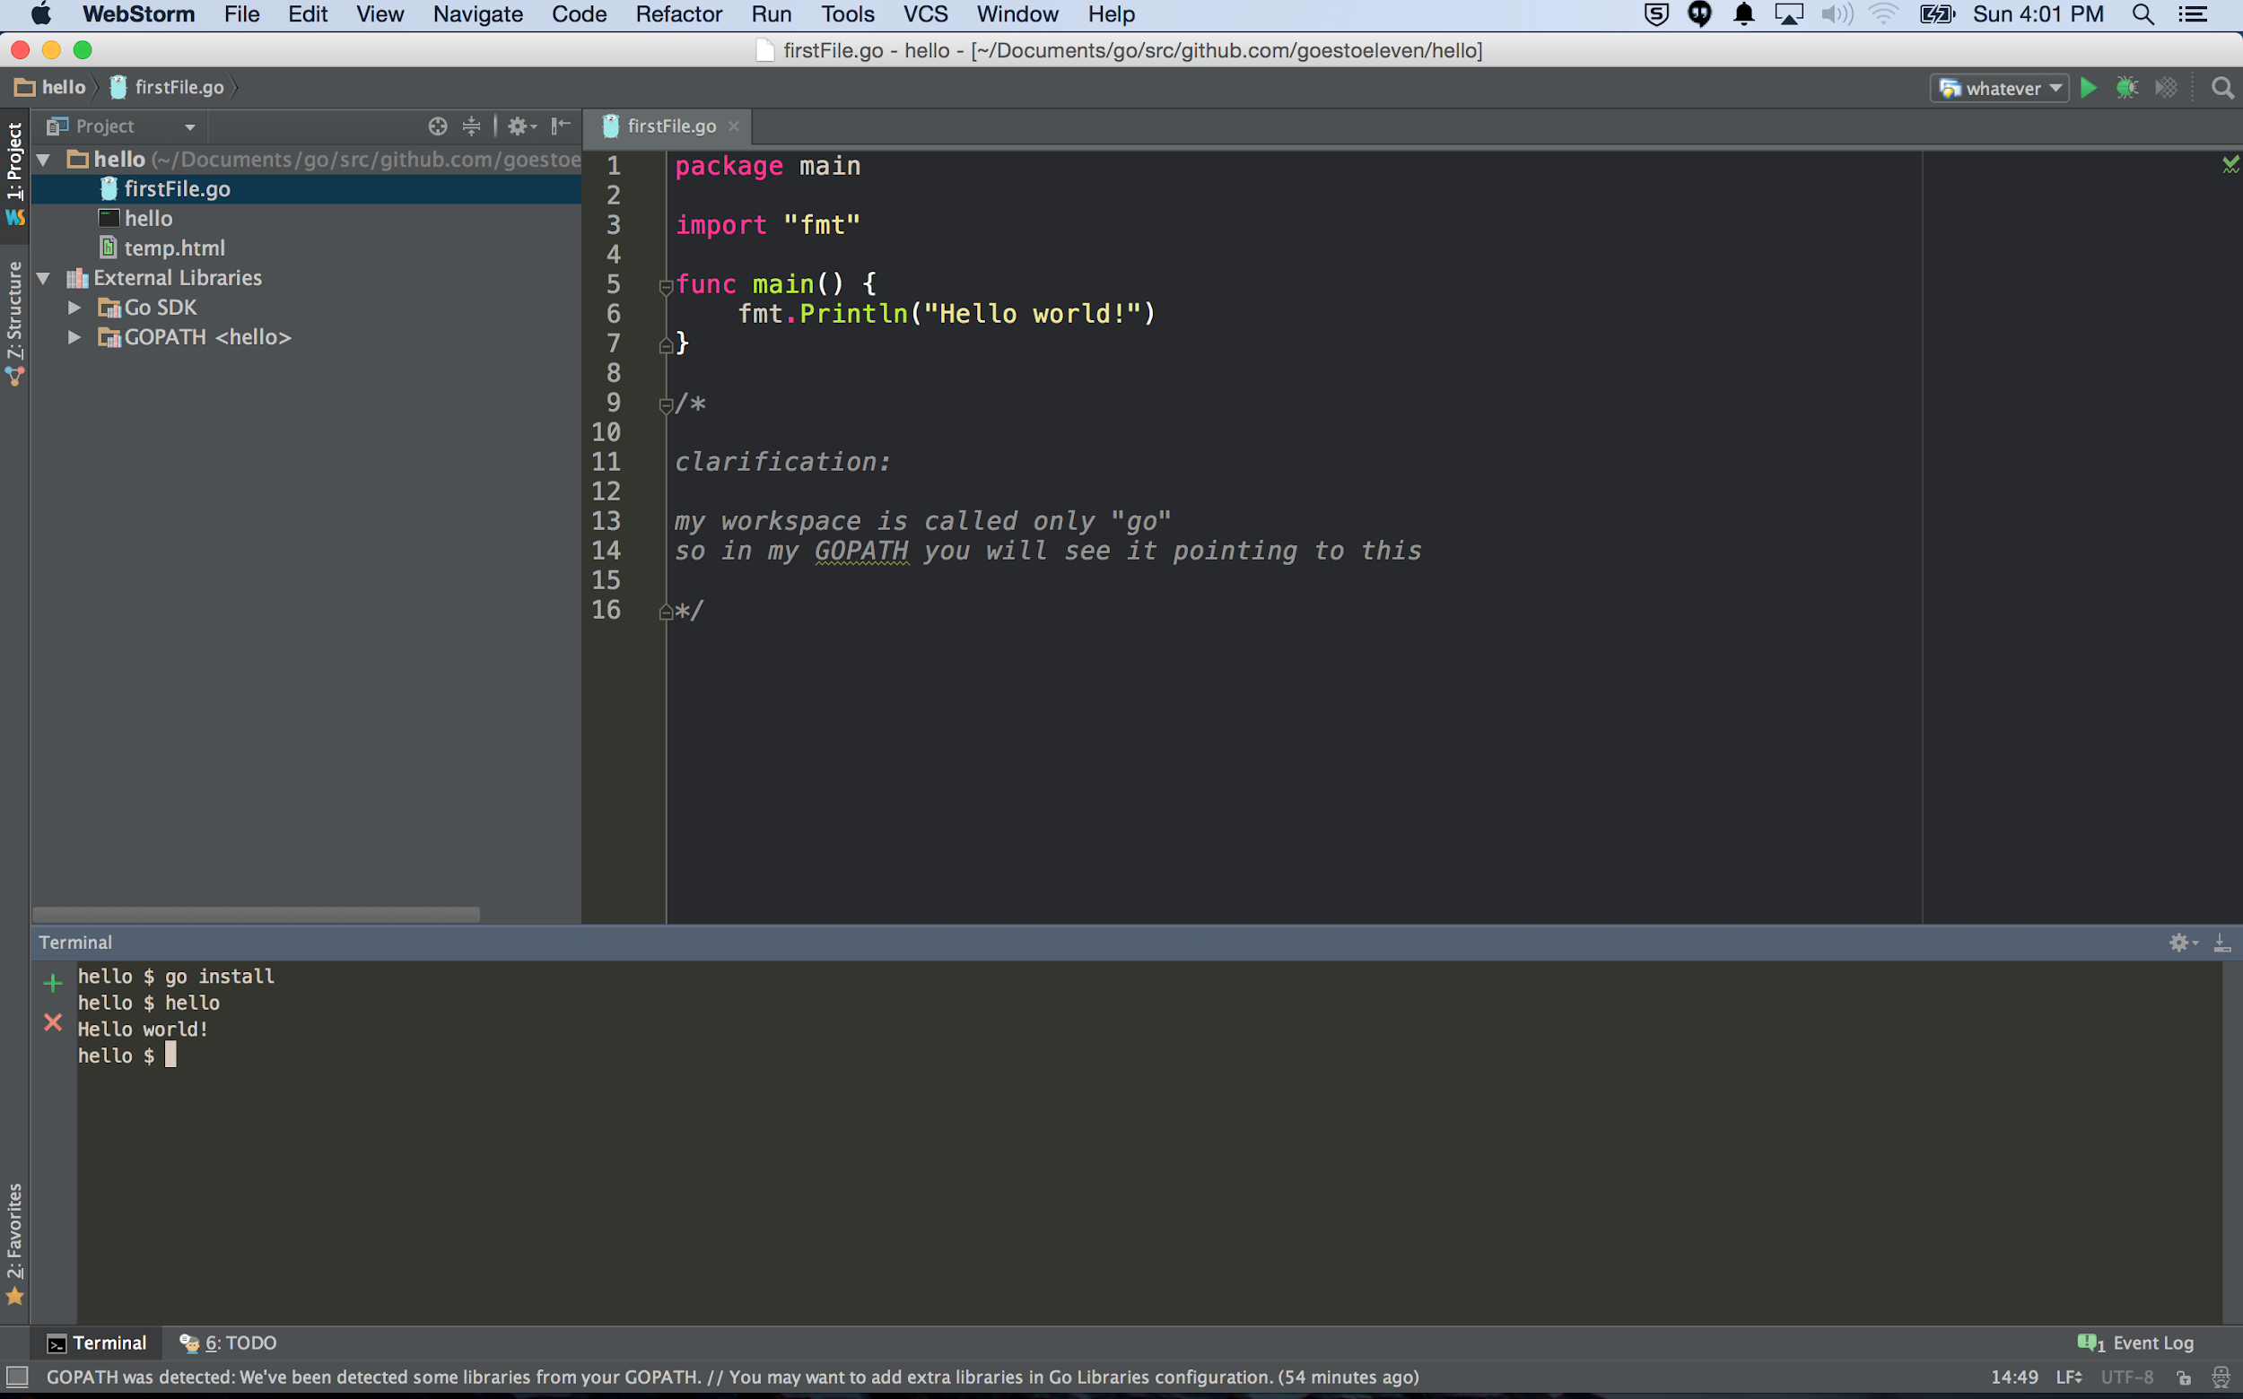
Once a program has been compiled and put into “bin” …
… as I have a path variable pointing to the bin folder …
… I can run my program by typing the program’s name …
… in this case, “hello”

Slide 28
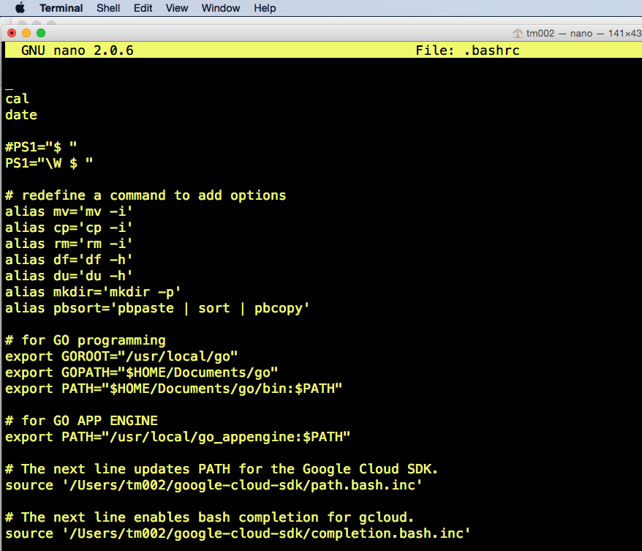
Once a program has been compiled and put into “bin” …
… as I have a path variable pointing to the bin folder …
… I can run my program by typing the program’s name …
… in this case, “hello”

Slide 29
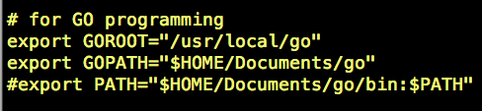
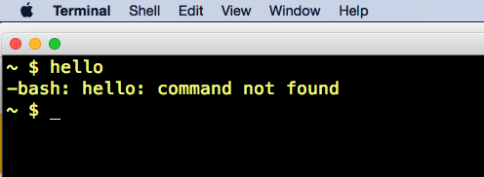
If I comment it out ...
… it doesn’t run.

Slide 30
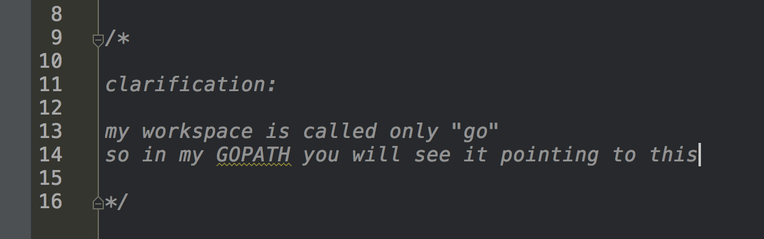
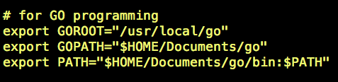

Slide 31
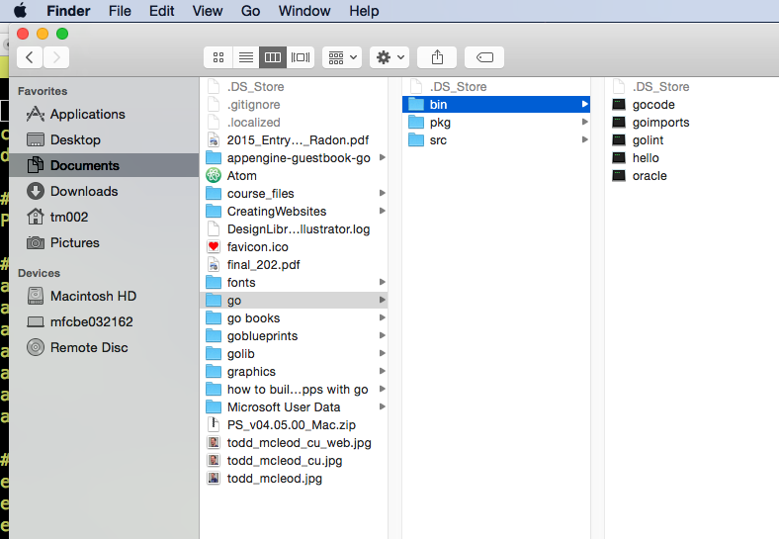
my go workspace

Slide 32
Review
code completion
package main
func main()
entry point for your program
packages, aka, libraries
import
functions
What makes a function accessible outside a package
capitalization
makes the function “public”
lowercase
function restricted to package
parameters vs arguments
expressions vs statements
variable, constant, literal
cmd + click → takes you to source code
go run
go run gofiles...
go build
go install

Slide 33
Review Questions

Slide 34
Package Main
What is the purpose of package main in a go program?
What function must package main contain?
Can package main contain a function called func blueSky() ?

Slide 35
funcs
What makes a func accessible outside a package?

Slide 36
Parameters vs Arguments
What is the difference between the two?

Slide 37
Expressions vs Statements
What is the difference between the two?

Slide 38
Variable, Constant, Literal
Define the three concepts above.
Give an example of a literal from the “hello world” example.

Slide 39
go run
Build “hello go” in your editor
use go run from the command line to make your “hello go” program execute

Slide 40
go build
Go build does what when run on a folder containing package main?

Slide 41
go build
Go build does what when run on a folder containing a library package?

Slide 42
go install
Go install does what when run on a folder containing package main?

Slide 43
go install
Go install does what when run on a folder containing a library package?

